Slide 1
Ray Tracing : In A Weekend (with a Python)
16 신지홍 정보컴퓨터공학부

Slide 2
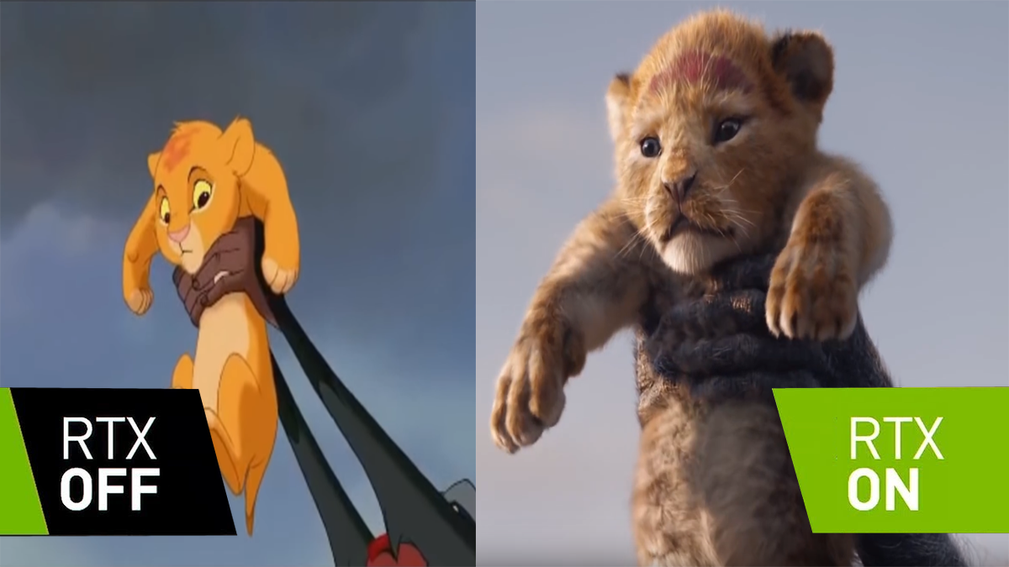

Slide 3
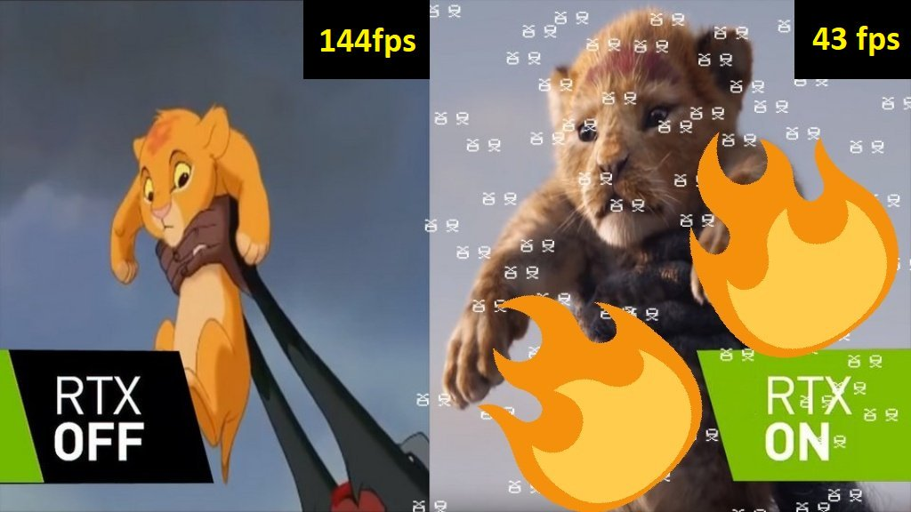
1) https://twitter.com/gamersnexus/status/1065921443790241793

Slide 4
RTX Graphics Card
1) interface for real-time ray tracing for rendering graphics that was created by Nvidia.
1) https://en.wikipedia.org/wiki/RTX

Slide 5

Rasterization vs Ray-Tracing
1) https://www.youtube.com/watch?v=frLwRLS_ZR0&feature=youtu.be

Slide 6

Ray-Tracing
천장
광원
카메라
바닥

Slide 7

Hello world!
PPM 파일 포맷
P3
3 2
255
255 0 0
0 255 0
0 0 255
255 255 0
255 255 255
0 0 0
1) https://en.wikipedia.org/wiki/Netpbm_format

Slide 8
Hello world!
width
for y in 0 ~ height :
height
for x in 0 ~ width :

Slide 9

Hello world!

Slide 10
Hello world!
width
(-2, -1, -1)
height
(+2, +1, -1)
1) https://www.youtube.com/watch?v=frLwRLS_ZR0&feature=youtu.be

Slide 11
References )
http://www.realtimerendering.com/raytracing/Ray%20Tracing%20in%20a%20Weekend.pdf
http://www.realtimerendering.com/raytracing/Ray%20Tracing_%20The%20Next%20Week.pdf

